Slide 1
Multinomial Logit
Sociology 8811 Lecture 10
Copyright © 2007 by Evan Schofer
Do not copy or distribute without permission

Slide 2
Announcements
Paper # 1 due March 8
    Look for data NOW!!!

Slide 3
Logit: Real World Example
Goyette, Kimberly and Yu Xie. 1999. “Educational Expectations of Asian American Youths: Determinants and Ethnic Differences.” Sociology of Education, 72, 1:22-36.
What was the paper about?
    What was the analysis?
    Dependent variable? Key independent variables?
    Findings?
    Issues / comments / criticisms?

Slide 4
Multinomial Logistic Regression
What if you want have a dependent variable with more than two outcomes?
    A “polytomous” outcome
  Ex: Mullen, Goyette, Soares (2003): What kind of grad school?
    None vs. MA vs MBA vs Prof’l School vs PhD.
  Ex: McVeigh & Smith (1999). Political action
    Action can take different forms: institutionalized action (e.g., voting) or protest
    Inactive vs. conventional pol action vs. protest
  Other examples?

Slide 5
Multinomial Logistic Regression
Multinomial Logit strategy: Contrast outcomes with a common “reference point”
    Similar to conducting a series of 2-outcome logit models comparing pairs of categories
    The “reference category” is like the reference group when using dummy variables in regression
      It serves as the contrast point for all analyses
  Example: Mullen et al. 2003: Analysis of 5 categories yields 4 tables of results:
      No grad school vs. MA
      No grad school vs. MBA
      No grad school vs. Prof’l school
      No grad school vs. PhD.

Slide 6
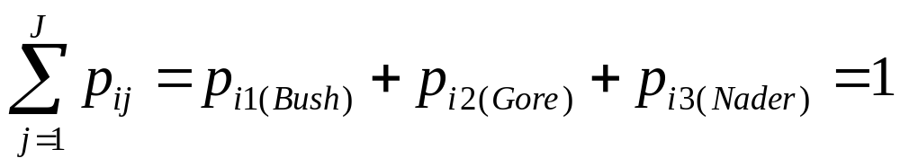
Multinomial Logistic Regression
Imagine a dependent variable with M categories
    Ex: j = 3; Voting for Bush, Gore, or Nader
  Probability of person “i” choosing category “j” must add to 1.0:

Slide 7
Multinomial Logistic Regression
Option #1: Conduct binomial logit models for all possible combinations of outcomes
    Probability of Gore vs. Bush
    Probability of Nader vs. Bush
    Probability of Gore vs. Nader
  Note: This will produce results fairly similar to a multinomial output…
    But: Sample varies across models
    Also, multinomial imposes additional constraints
    So, results will differ somewhat from multinomial logistic regression.

Slide 8
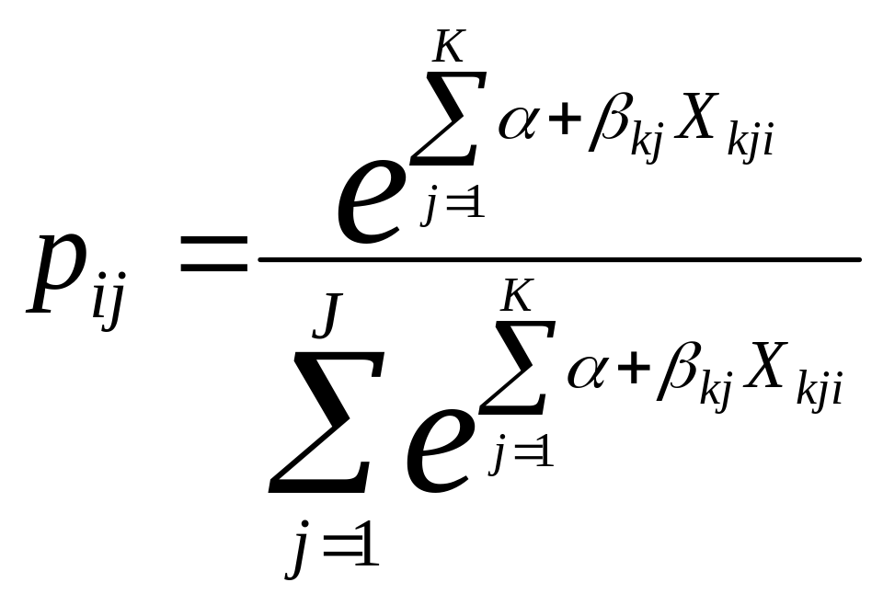
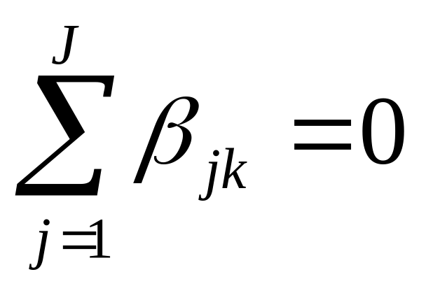
Multinomial Logistic Regression
We can model probability of each outcome as:
    i = cases, j categories, k = independent variables
Solved by adding constraint
    Coefficients sum to zero

Slide 9
Multinomial Logistic Regression
Option #2: Multinomial logistic regression
  Choose one category as “reference”…
    Probability of Gore vs. Bush
    Probability of Nader vs. Bush
    Probability of Gore vs. Nader
Let’s make Bush the reference category
Output will include two tables:
    Factors affecting probability of voting for Gore vs. Bush
    Factors affecting probability of Nader vs. Bush.

Slide 10
Multinomial Logistic Regression
Choice of “reference” category drives interpretation of multinomial logit results
    Similar to when you use dummy variables…
    Example: Variables affecting vote for Gore would change if reference was Bush or Nader!
      What would matter in each case?
  1. Choose the contrast(s) that makes most sense
    Try out different possible contrasts
  2. Be aware of the reference category when interpreting results
    Otherwise, you can make BIG mistakes
    Effects are always in reference to the contrast category.

Slide 11
MLogit Example: Family Vacation
Mode of Travel. Reference category = Train
. mlogit mode income familysize
Multinomial logistic regression Number of obs = 152
LR chi2(4) = 42.63
Prob > chi2 = 0.0000
Log likelihood = -138.68742 Pseudo R2 = 0.1332
------------------------------------------------------------------------------
mode | Coef. Std. Err. z P>|z| [95% Conf. Interval]
-------------+----------------------------------------------------------------
Bus |
income | .0311874 .0141811 2.20 0.028 .0033929 .0589818
family size | -.6731862 .3312153 -2.03 0.042 -1.322356 -.0240161
_cons | -.5659882 .580605 -0.97 0.330 -1.703953 .5719767
-------------+----------------------------------------------------------------
Car |
income | .057199 .0125151 4.57 0.000 .0326698 .0817282
family size | .1978772 .1989113 0.99 0.320 -.1919817 .5877361
_cons | -2.272809 .5201972 -4.37 0.000 -3.292377 -1.253241
------------------------------------------------------------------------------
(mode==Train is the base outcome)
Large families less likely to take bus (vs. train)
Note: It is hard to directly compare Car vs. Bus in this table

Slide 12
MLogit Example: Car vs. Bus vs. Train
Mode of Travel. Reference category = Car
. mlogit mode income familysize, base(3)
Multinomial logistic regression Number of obs = 152
LR chi2(4) = 42.63
Prob > chi2 = 0.0000
Log likelihood = -138.68742 Pseudo R2 = 0.1332
------------------------------------------------------------------------------
mode | Coef. Std. Err. z P>|z| [95% Conf. Interval]
-------------+----------------------------------------------------------------
Train |
income | -.057199 .0125151 -4.57 0.000 -.0817282 -.0326698
family size | -.1978772 .1989113 -0.99 0.320 -.5877361 .1919817
_cons | 2.272809 .5201972 4.37 0.000 1.253241 3.292377
-------------+----------------------------------------------------------------
Bus |
income | -.0260117 .0139822 -1.86 0.063 -.0534164 .001393
family size | -.8710634 .3275472 -2.66 0.008 -1.513044 -.2290827
_cons | 1.706821 .6464476 2.64 0.008 .439807 2.973835
------------------------------------------------------------------------------
(mode==Car is the base outcome)
Here, the pattern is clearer: Wealthy & large families use cars

Slide 13
Stata Notes: mlogit
Dependent variable: any categorical variable
    Don’t need to be positive or sequential
    Ex: Bus = 1, Train = 2, Car = 3
      Or: Bus = 0, Train = 10, Car = 35
Base category can be set with option:
    mlogit mode income familysize, baseoutcome(3)
Exponentiated coefficients called “relative risk ratios”, rather than odds ratios
    mlogit mode income familysize, rrr

Slide 14
MLogit Example: Car vs. Bus vs. Train
Exponentiated coefficients: relative risk ratios
Multinomial logistic regression Number of obs = 152
LR chi2(4) = 42.63
Prob > chi2 = 0.0000
Log likelihood = -138.68742 Pseudo R2 = 0.1332
------------------------------------------------------------------------------
mode | RRR Std. Err. z P>|z| [95% Conf. Interval]
-------------+----------------------------------------------------------------
Train |
income | .9444061 .0118194 -4.57 0.000 .9215224 .9678581
familysize | .8204706 .1632009 -0.99 0.320 .5555836 1.211648
-------------+----------------------------------------------------------------
Bus |
income | .9743237 .0136232 -1.86 0.063 .9479852 1.001394
familysize | .4185063 .1370806 -2.66 0.008 .2202385 .7952627
------------------------------------------------------------------------------
(mode==Car is the base outcome)
exp(-.057)=.94. Interpretation is just like odds ratios… BUT comparison is with reference category.

Slide 15
Predicted Probabilities
You can predict probabilities for each case
    Each outcome has its own probability (they add up to 1)
. predict predtrain predbus predcar if e(sample), pr
. list predtrain predbus predcar
+--------------------------------+
| predtrain predbus predcar |
|--------------------------------|
1. | .3581157 .3089684 .3329159 |
2. | .448882 .1690205 .3820975 |
3. | .3080929 .3106668 .3812403 |
4. | .0840841 .0562263 .8596895 |
5. | .2771111 .1665822 .5563067 |
6. | .5169058 .279341 .2037531 |
7. | .5986157 .2520666 .1493177 |
8. | .3080929 .3106668 .3812403 |
9. | .0934616 .1225238 .7840146 |
10. | .6262593 .1477046 .2260361 |
This case has a high predicted probability of traveling by car
This probabilities are pretty similar here…

Slide 16
Classification of Cases
Stata doesn’t have a fancy command to compute classification tables for mlogit
    But, you can do it manually
    Assign cases based on highest probability
  You can make table of all classifications, or just if they were classified correctly
. gen predcorrect = 0
. replace predcorrect = 1 if pmode == mode
(85 real changes made)
. tab predcorrect
predcorrect | Freq. Percent Cum.
------------+-----------------------------------
0 | 67 44.08 44.08
1 | 85 55.92 100.00
------------+-----------------------------------
Total | 152 100.00
First, I calculated the “predicted mode” and a dummy indicating whether prediction was correct
56% of cases were classified correctly

Slide 17
Predicted Probability Across X Vars
Like logit, you can show how probabilies change across independent variables
    However, “adjust” command doesn’t work with mlogit
    So, manually compute mean of predicted probabilities
      Note: Other variables will be left “as is” unless you set them manually before you use “predict”
. mean predcar, over(familysize)
---------------------------
Over | Mean
-------------+-------------
predcar |
1 | .2714656
2 | .4240544
3 | .6051399
4 | .6232910
5 | .8719671
6 | .8097709
Probability of using car increases with family size
Note: Values bounce around because other vars are not set to common value.
Note 2: Again, scatter plots aid in summarizing such results

Slide 18
Stata Notes: mlogit
Like logit, you can’t include variables that perfectly predict the outcome
    Note: Stata “logit” command gives a warning of this
    mlogit command doesn’t give a warning, but coefficient will have z-value of zero, p-value =1
    Remove problematic variables if this occurs!

Slide 19
Hypothesis Tests
Individual coefficients can be tested as usual
    Wald test/z-values provided for each variable
However, adding a new variable to model actually yields more than one coefficient
    If you have 4 categories, you’ll get 3 coefficients
    LR tests are especially useful because you can test for improved fit across the whole model

Slide 20
LR Tests in Multinomial Logit
Example: Does “familysize” improve model?
    Recall: It wasn’t always significant… maybe not!
  Run full model, save results
    mlogit mode income familysize
    estimates store fullmodel
  Run restricted model, save results
    mlogit mode income
    estimates store smallmodel
  Compare: lrtest fullmodel smallmodel
Yes, model fit is significantly improved
Likelihood-ratio test LR chi2(2) = 9.55
(Assumption: smallmodel nested in fullmodel) Prob > chi2 = 0.0084

Slide 21
Multinomial Logit Assumptions: IIA
Multinomial logit is designed for outcomes that are not complexly interrelated
Critical assumption: Independence of Irrelevant Alternatives (IIA)
    Odds of one outcome versus another should be independent of other alternatives
      Problems often come up when dealing with individual choices…
    Multinomial logit is not appropriate if the assumption is violated.

Slide 22
Multinomial Logit Assumptions: IIA
IIA Assumption Example:
  Odds of voting for Gore vs. Bush should not change if Nader is added or removed from ballot
    If Nader is removed, those voters should choose Bush & Gore in similar pattern to rest of sample
  Is IIA assumption likely met in election model?
  NO! If Nader were removed, those voters would likely vote for Gore
    Removal of Nader would change odds ratio for Bush/Gore.

Slide 23
Multinomial Logit Assumptions: IIA
IIA Example 2: Consumer Preferences
  Options: coffee, Gatorade, Coke
    Might meet IIA assumption
  Options: coffee, Gatorade, Coke, Pepsi
    Won’t meet IIA assumption. Coke & Pepsi are very similar – substitutable.
    Removal of Pepsi will drastically change odds ratios for coke vs. others.

Slide 24
Multinomial Logit Assumptions: IIA
Solution: Choose categories carefully when doing multinomial logit!
    Long and Freese (2006), quoting Mcfadden:
    “Multinomial and conditional logit models should only be used in cases where the alternatives “can plausibly be assumed to be distinct and weighed independently in the eyes of the decisionmaker.”
    Categories should be “distinct alternatives”, not substitutes
  Note: There are some formal tests for violation of IIA. But they don’t work well. Don’t use them.
    See Long and Freese (2006) p. 243

Slide 25
Multinomial Assumptions/Problems
Aside from IIA, assumptions & problems of multinomial logit are similar to standard logit
    Sample size
      You often want to estimate MANY coefficients, so watch out for small N
    Outliers
    Multicollinearity
    Model specification / omitted variable bias
    Etc.

Slide 26
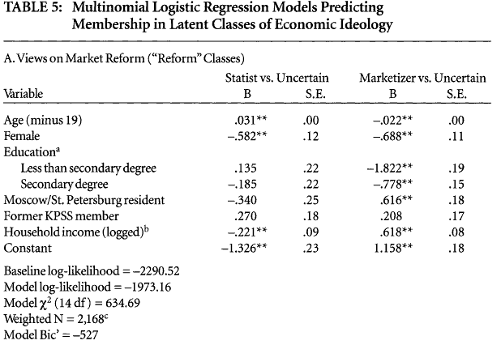
Real-World Multinomial Example
Gerber (2000): Russian political views
    Prefer state control or Market reforms vs. uncertain
Older Russians more likely to support state control of economy (vs. being uncertain)
Younger Russians prefer market reform (vs. uncertain)

Slide 27
Other Logit-type Models
Ordered logit: Appropriate for ordered categories
    Useful for non-interval measures
    Useful if there are too few categories to use OLS
Conditional Logit
    Useful for “alternative specific” data
      Ex: Data on characteristics of voters AND candidates
Problems with IIA assumption
    Nested logit
    Alternative specific multinomial probit
And others!

